Slide 2




What is a Digital marketplace
Department Of business informatics and operations management
Thomas Derave

Slide 3
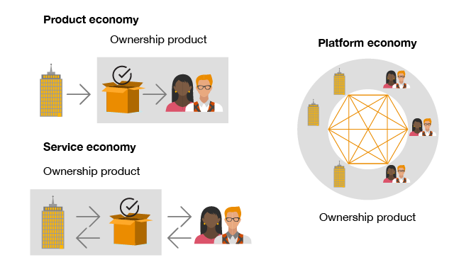
Platform Economy

Slide 4
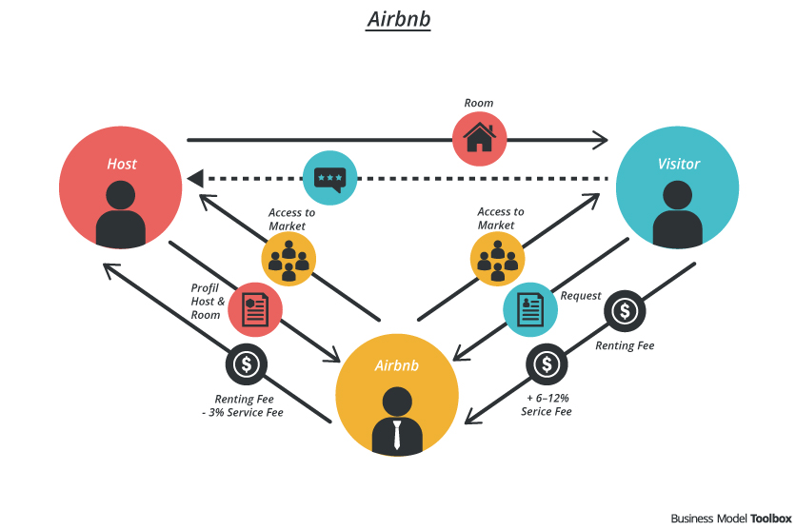
Digital Marketplace

Slide 5
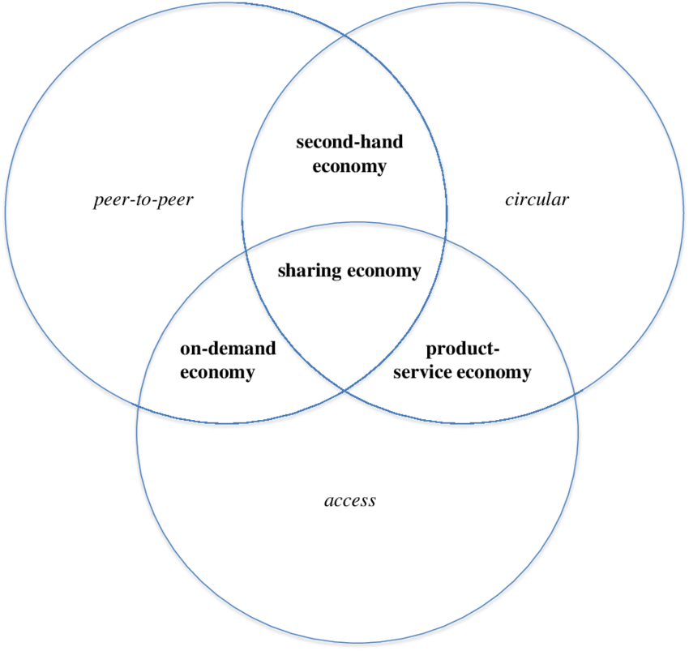
Sharing economy
Digital marketplace

Slide 6
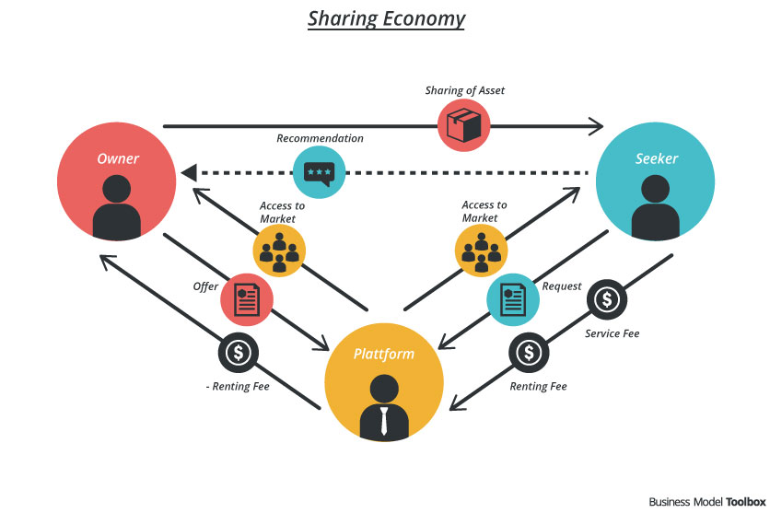



Sharing Economy

Slide 7
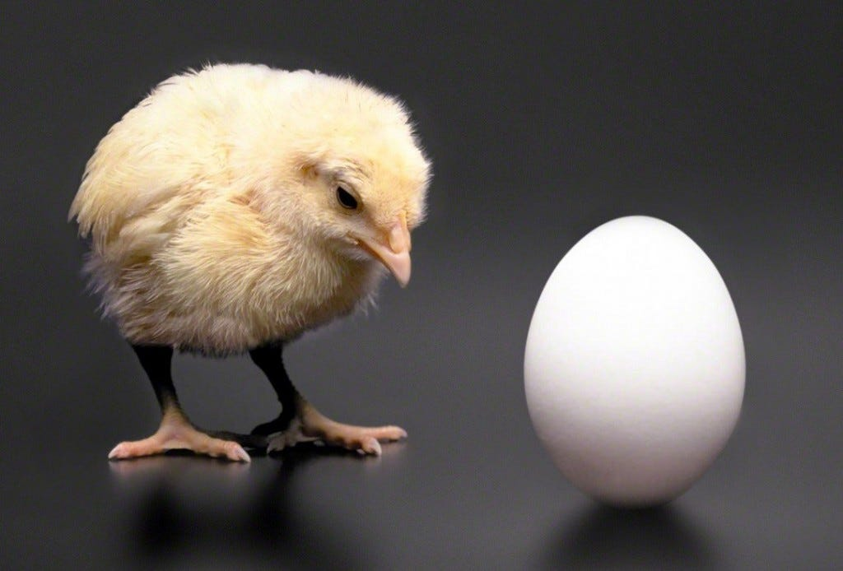
Chicken and the Egg problem

Slide 8
Minimum Viable Platform (MVP)
Department Of business informatics and operations management
Thomas Derave

Slide 9
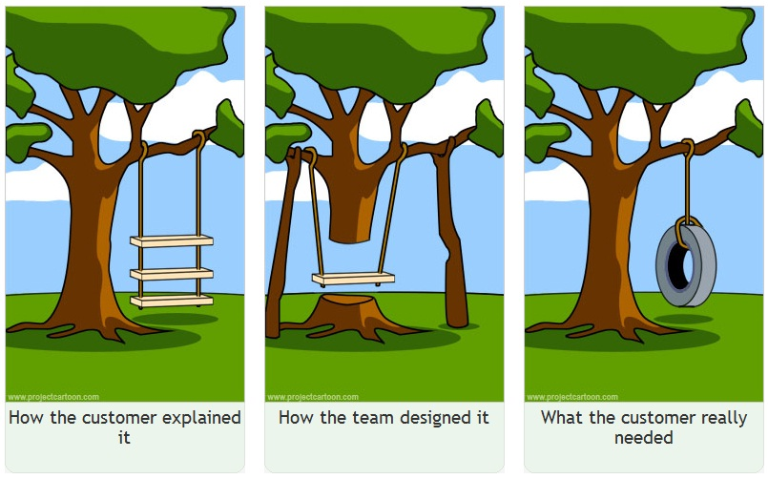
Waterfall method

Slide 10
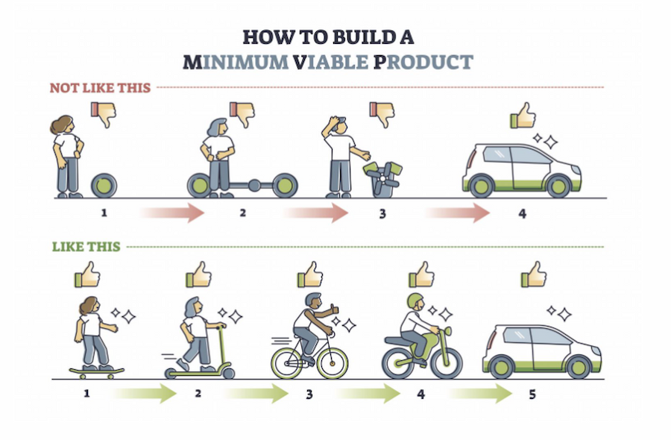
Agile and MVP (Minimum Viable Platform

Slide 11
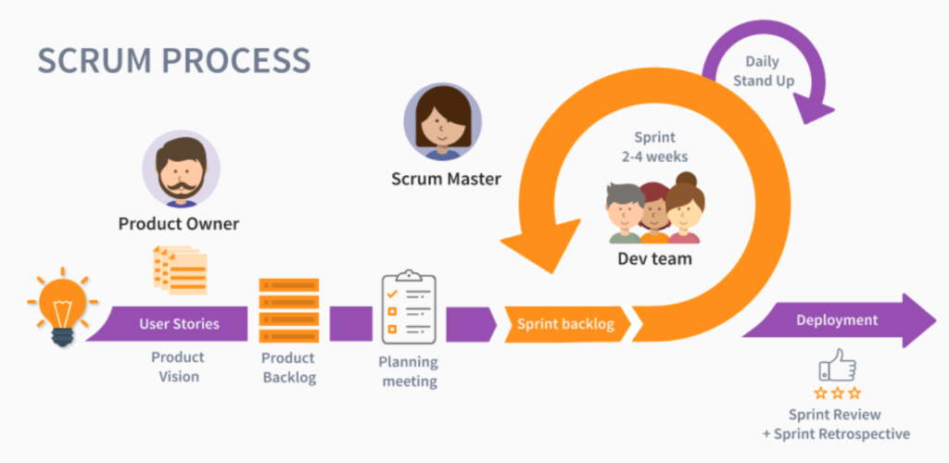
SCrum

Slide 12
Marketplace IDea
Department Of business informatics and operations management
Thomas Derave

Slide 13
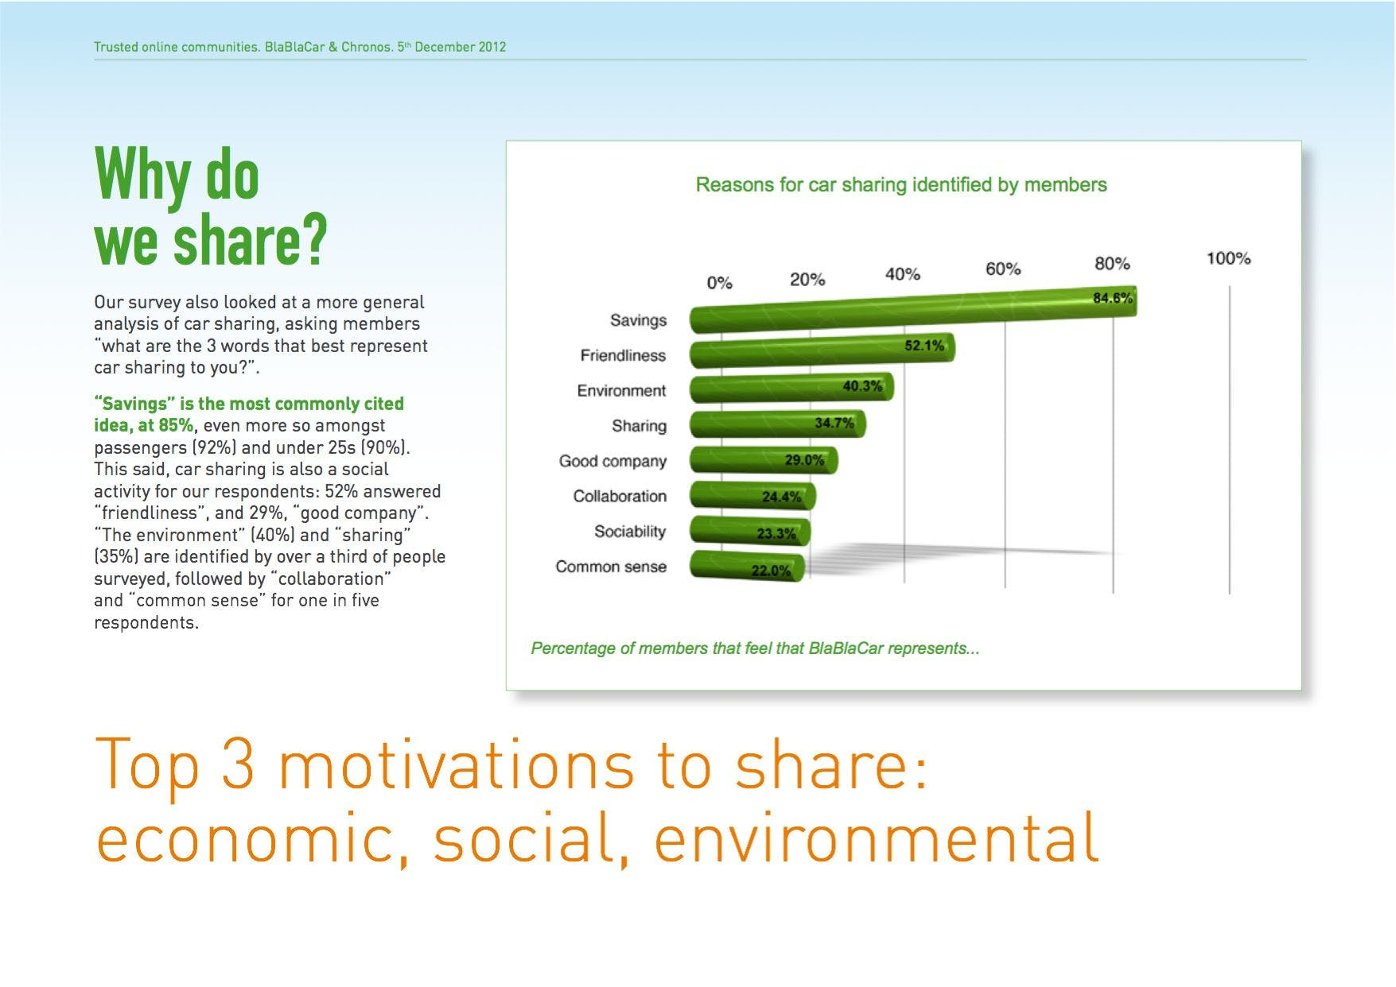
Solve real problem for your users

Slide 14
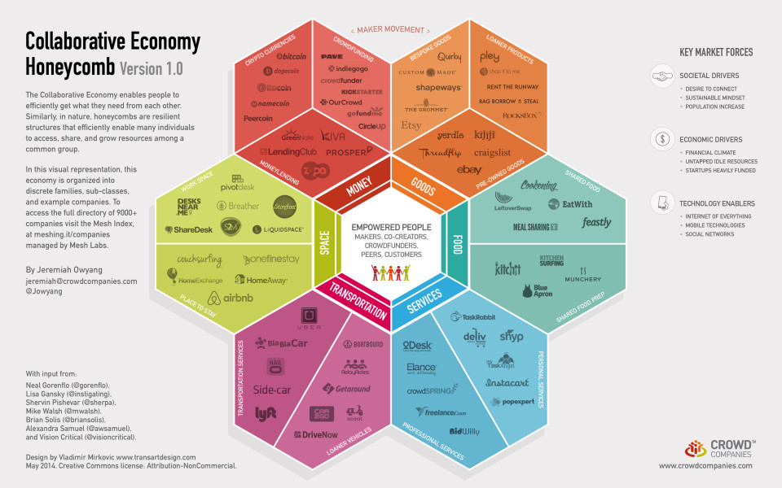
Unlock Idle assets

Slide 15
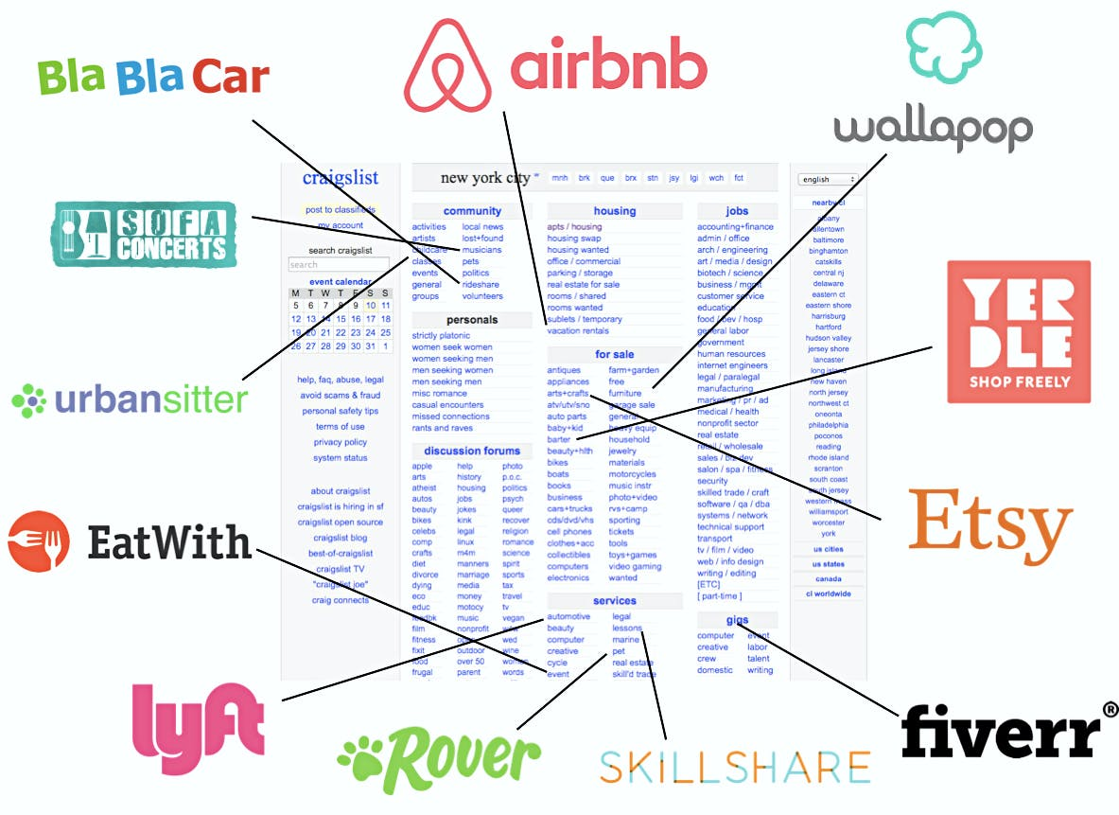
Add layer of trust

Slide 16
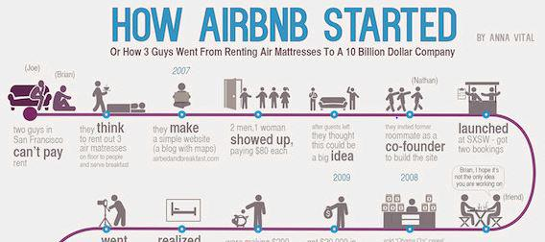
Narrow focus (Niche)

Slide 17
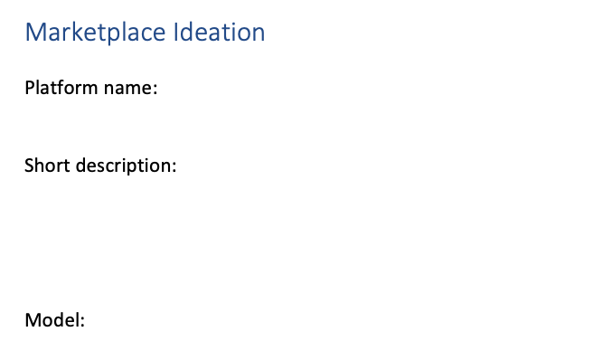
ideation

Slide 18
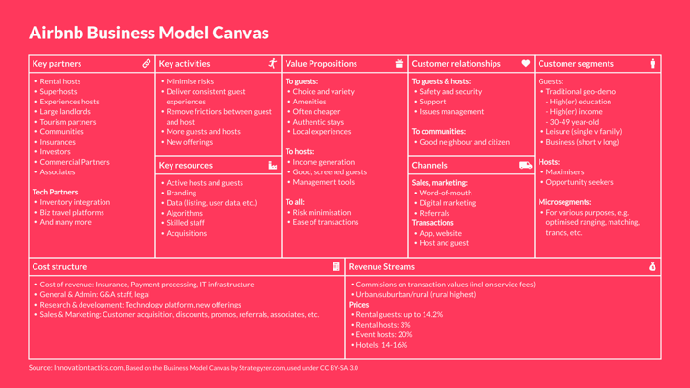
Business Model Canvas

Slide 19

Thomas Derave
PhD Student and assistent
Faculty of Economics and Business Administration
Department of Business Informatics and Operations Management
thomas.derave@ugent.be
www.model-a-platform.com

